Slide 1

RATIONMATE
SHIFANA NASRIN
MES24MCA-2052
Department of Computer Applications
MES College of Engineering, Kuttippuram
20-08-2025

Slide 2
PRODUCT OWNER MRS.RESHMI K ASSISTANT PROFESSOR DEPARTMENT OF COMPUTER APPLICATIONS MES COLLEGE OF ENGINEERING, KUTTIPPURAM

Slide 3
TABLE OF CONTENTS
Introduction
Objective
Existing System
Proposed System
Motivation
Functionalities
Module Description
Developing Environment
Sprint Backlog
Product Backlog
User Story
Project Plans
Data Flow Diagrams
ER Diagram

Slide 4
RATIONMATE
Mobile app for ration card holder in Kerala.
Tracks monthly ration entitlements.
Sends notifications for special schemes like Onam kit.
Displays shop open/closed status for the day
Support Malayalam and English
Work offline for rural accessibility.

Slide 5
OBJECTIVES
Display user’s monthly ration items and quantites.
Notify about special government schemes.
Show ration shop statu

Slide 6
EXISTING SYSTEM
Write Existing system using bullet points (1 Slide)

Slide 7
PROPOSED SYSTEM
Write Proposed system using bullet points (1 Slide)

Slide 8
MOTIVATIONS
Write Project Motivations using bullet points (1 Slide)

Slide 9
FUNCTIONALITIES
Write Project Functionalities with short description using bullet points (1 to 2 Slide)

Slide 10
MODULE DESCRIPTION
Write Module Descriptions using bullet points (1 to 2 Slide)

Slide 11
DEVELOPING ENVIRONMENT
Write the software tools/technologies used for developing the project like Operating System, Front End, Back End, Database, Framework, IDE etc..

Slide 12
SPRINT BACKLOG
Backlog tem | Status And Completion Date | Original Estimation in Hours | Day 1 hrs | Day 2 hrs | Day 3 hrs | Day 4 hrs | Day 5 hrs | Day 6 hrs | Day 7 hrs | Day 8 hrs | Day 9 hrs | Day 10 hrs
SPRINT1
Table designing | 16/8/2022 | 2 | 1 | 1 | 0 | 0 | 0 | 0 | 0 | 0 | 0 | 0
Form designing | 22/8/2022 | 3 | 1 | 1 | 1 | 0 | 0 | 0 | 0 | 0 | 0 | 0
Coding | 27/8/2022 | 3 | 1 | 1 | 1 | 0 | 0 | 0 | 0 | 0 | 0 | 0
SPRINT 2
Data collection | 13/9/2022 | 7 | 1 | 1 | 1 | 1 | 1 | 1 | 1 | 0 | 0 | 0
Data processing | 29/9/2022 | 7 | 1 | 1 | 1 | 1 | 1 | 1 | 1 | 0 | 0 | 0
The table given above is for reference only. Update/create a table with your data.

Slide 13
SPRINT BACKLOG
Backlog tem | Status And Completion Date | Original Estimation in Hours | Day 1 hrs | Day 2 hrs | Day 3 hrs | Day 4 hrs | Day 5 hrs | Day 6 hrs | Day 7 hrs | Day 8 hrs | Day 9 hrs | Day 10 hrs
SPRINT3
Course contents | 3/10/2022 | 7 | 1 | 1 | 1 | 1 | 1 | 1 | 1 | 0 | 0 | 0
Assassement | 20/10/2022 | 7 | 1 | 1 | 1 | 1 | 1 | 1 | 1 | 0 | 0 | 0
SPRINT 4
Certificate | 8/11/2022 | 7 | 1 | 1 | 1 | 1 | 1 | 1 | 1 | 0 | 0 | 0
Testing | 15/11/2022 | 7 | 1 | 1 | 1 | 1 | 1 | 1 | 1 | 0 | 0 | 0
TOTAL |  | 50 | 9 | 9 | 8 | 6 | 6 | 6 | 6
The table given above is for reference only. Update/create a table with your data.

Slide 14
PRODUCT BACKLOG
ID | NAME | PRIORITY <high/medium/low> | ESTIMATE (Hours) | STATUS <Planned/In progress/Completed>
1 | REGISTRATION | High | 5 | COMPLETED
2 | LOGIN | High | 5 | COMPLETED
3 | CRUD(Course,Student,University) OPERATIONS | High | 20 | COMPLETED
4 | STUDENT ENROLLMENT | High | 10 | COMPLETED
5 | CERTIFICATE GENERATION | MEDIUM | 10 | COMPLETED
The table given above is for reference only. Update/create a table with your data.

Slide 15
USER STORY
User Story ID | As a type of User | I want to <Perform some task> | So that i can <Achieve Some Goal>
1 | ADMIN | Login | login successful with correct username and password
2 | ADMIN | View and Manage | Can view and Manage registered users,Faculties and Universities
3 | ADMIN | Verification | Verify Courses
4 | USER | Register | Can users register
5 | USER | Login | login successful with correct username and password
6 | USER | Enrollment | Can enroll in any Courses
7 | USER | View Profile | View users profile in application
The table given above is for reference only. Update/create a table with your data.

Slide 16
PROJECT PLAN
User StoryID | Task Name | Start Date | End Date | Days | Status
1 | Sprint 1 | 16/08/2022 | 17/08/2022 | 10 | Completed
4 |  | 18/08/2022 | 19/08/2022 |  | Completed
5 |  | 20/08/2022 | 22/08/2022 |  | Completed
10 |  | 23/08/2022 | 24/08/2022 |  | Completed
11 |  | 25/08/2022 | 27/08/2022 |  | Completed
2 | Sprint 2 | 13/09/2022 | 23/09/2022 | 16 | Completed
7 |  | 23/09/2022 | 24/09/2022 |  | Completed
12 |  | 24/09/2022 | 29/09/2022 |  | Completed
The table given above is for reference only. Update/create a table with your data.

Slide 17
PROJECT PLAN
User StoryID | Task Name | Start Date | End Date | Days | Status
3 | SPRINT 3 | 03/10/2022 | 06/10/2022 | 14 | Completed
6 |  | 07/10/2022 | 10/10/2022 |  | Completed
13 |  | 13/10/2022 | 20/10/2022 |  | Completed
14 | SPRINT 4 | 28/10/2022 | 5/11/2022 | 10 | Completed
8 |  | 7/11/2022 | 11/11/2022 |  | Completed
9 |  | 13/11/2022 | 15/11/2022 |  | Completed
The table given above is for reference only. Update/create a table with your data.

Slide 18
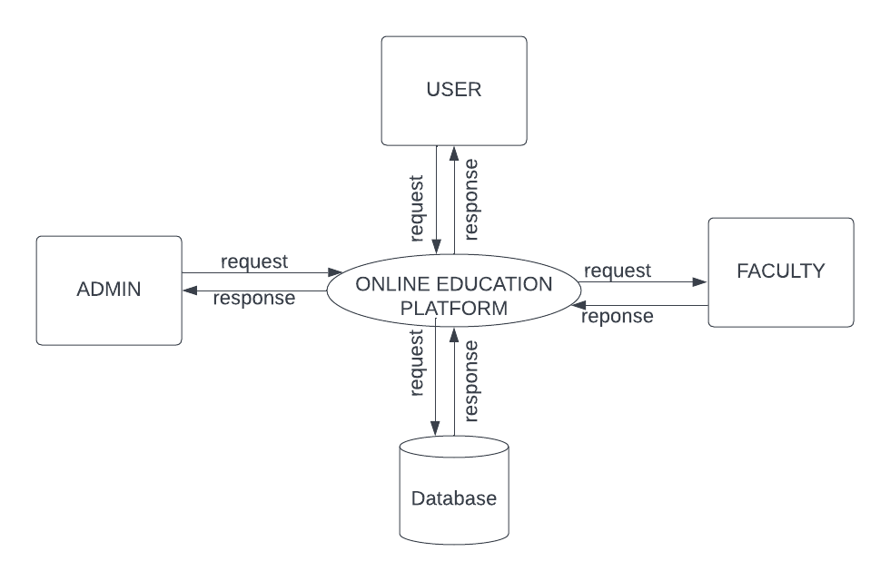
DATA FLOW DIAGRAM
LEVEL 1
The figure given above is for reference only. Create a figure with your data.

Slide 19
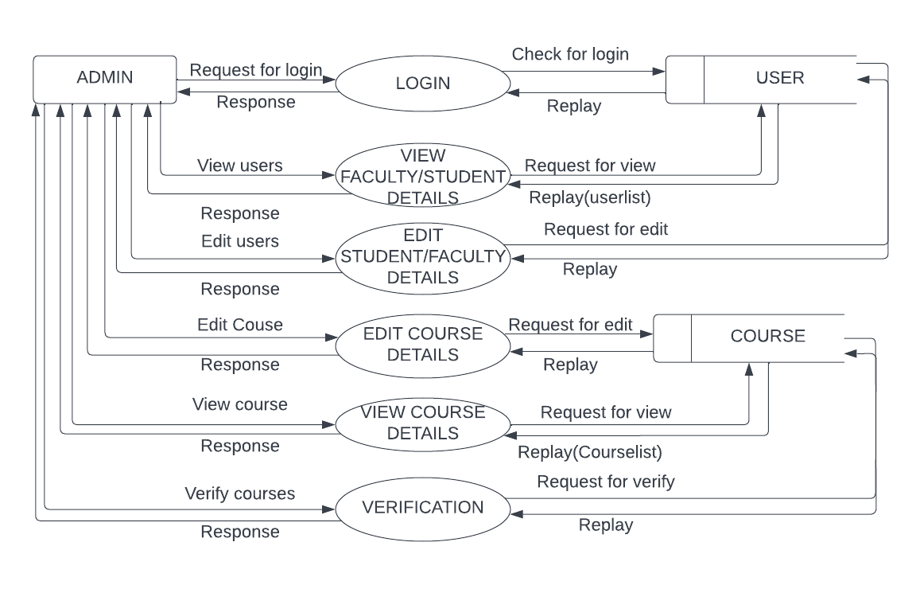
DATA FLOW DIAGRAM
Level 1.1
The figure given above is for reference only. Create a figure with your data.

Slide 20
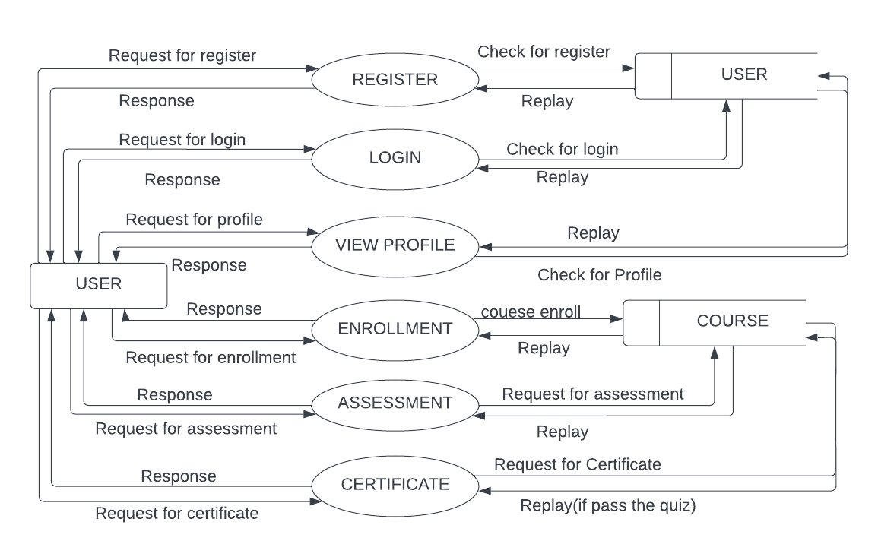
DATA FLOW DIAGRAM
Level 1.2
The figure given above is for reference only. Create a figure with your data.

Slide 21
ER DIAGRAM
Place you ER Diagram (if any) here.

Slide 22
THANK YOU

